Slide 1
Computer Networks
Multiple Access
- Controlled and Channelization Methods
S.V.Jansi Rani
Associate Professor / CSE

Slide 2
Agenda
Medium Access Control
Controlled Access
Reservation
Polling
Token Passing
Channelization Protocols
FDMA
TDMA
CDMA

Slide 3



Slide 4
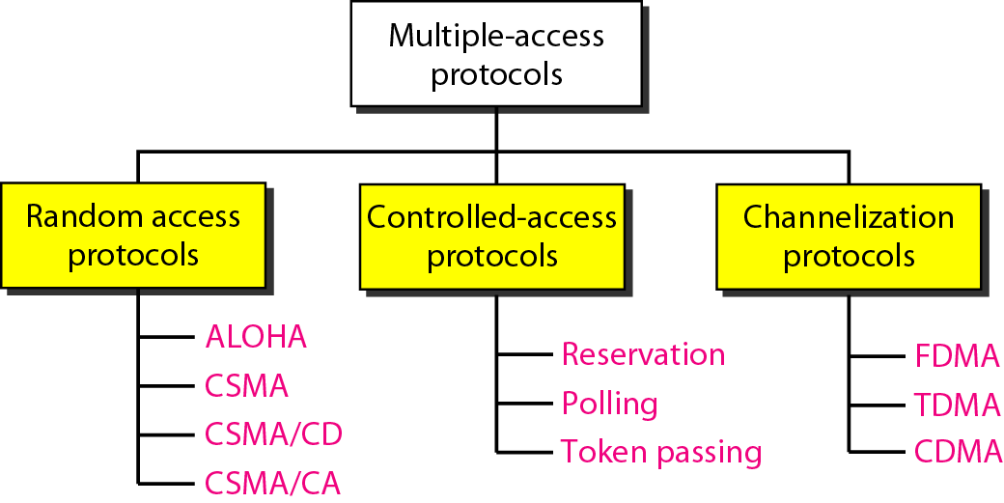
Taxonomy of Multiple-Access / Medium Access protocols

Slide 5
12-2 CONTROLLED ACCESS
In controlled access, the stations consult one another to find which station has the right to send. A station cannot send unless it has been authorized by other stations.
Reservation Polling Token Passing

Slide 6
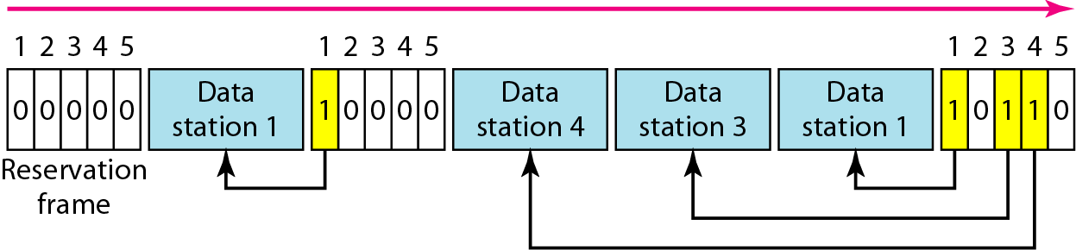
Reservation access method

Slide 7
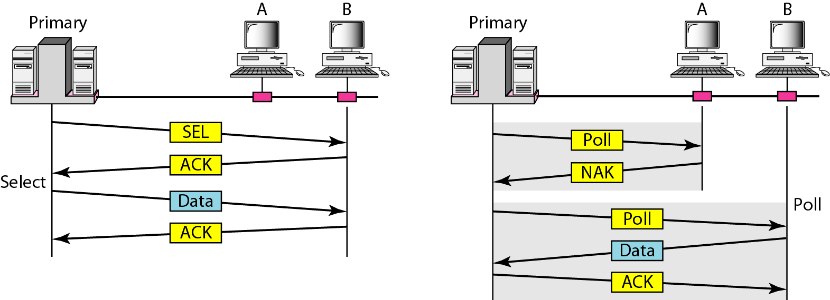
Select and poll functions in polling access method

Slide 8
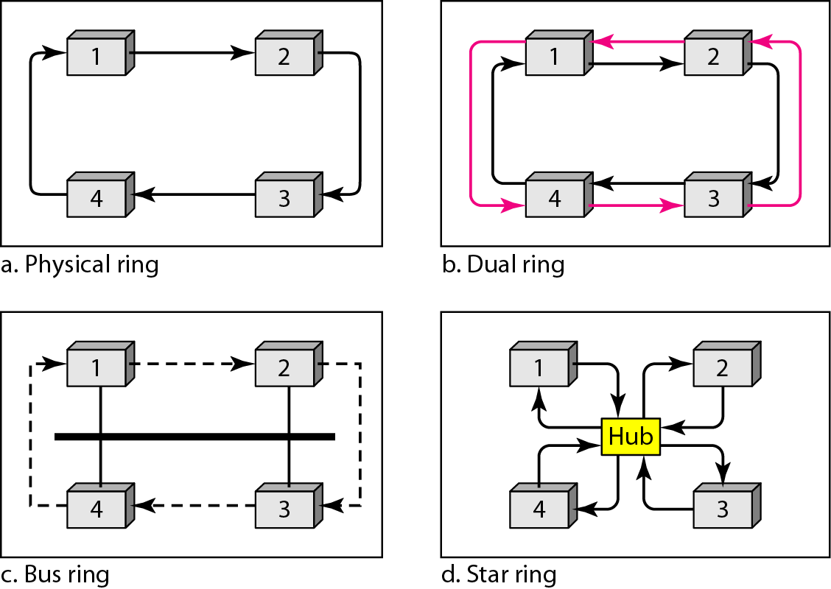
Logical ring and physical topology in token-passing access method

Slide 9
CHANNELIZATION
Channelization is a multiple-access method in which the available bandwidth of a link is shared in time, frequency, or through code, between different stations
FDMA
TDMA
CDMA

Slide 10

Note
In FDMA, the available bandwidth of the common channel is divided into bands that are separated by guard bands.

Slide 11
FDMA
Specifies a predetermined frequency band for the entire period of communication – stream data
FDM - physical layer technique that combines the loads from low bandwidth channels and transmits them by using a high-bandwidth channel.
The channels that are combined are low-pass.
The multiplexer modulates the signals, combines them, and creates a band-pass signal.
The bandwidth of each channel is shifted by the mux.
FDMA -access method in the data-link layer.
The data link layer in each station tells its physical layer to make a band-pass signal from the data passed to it.

Slide 12
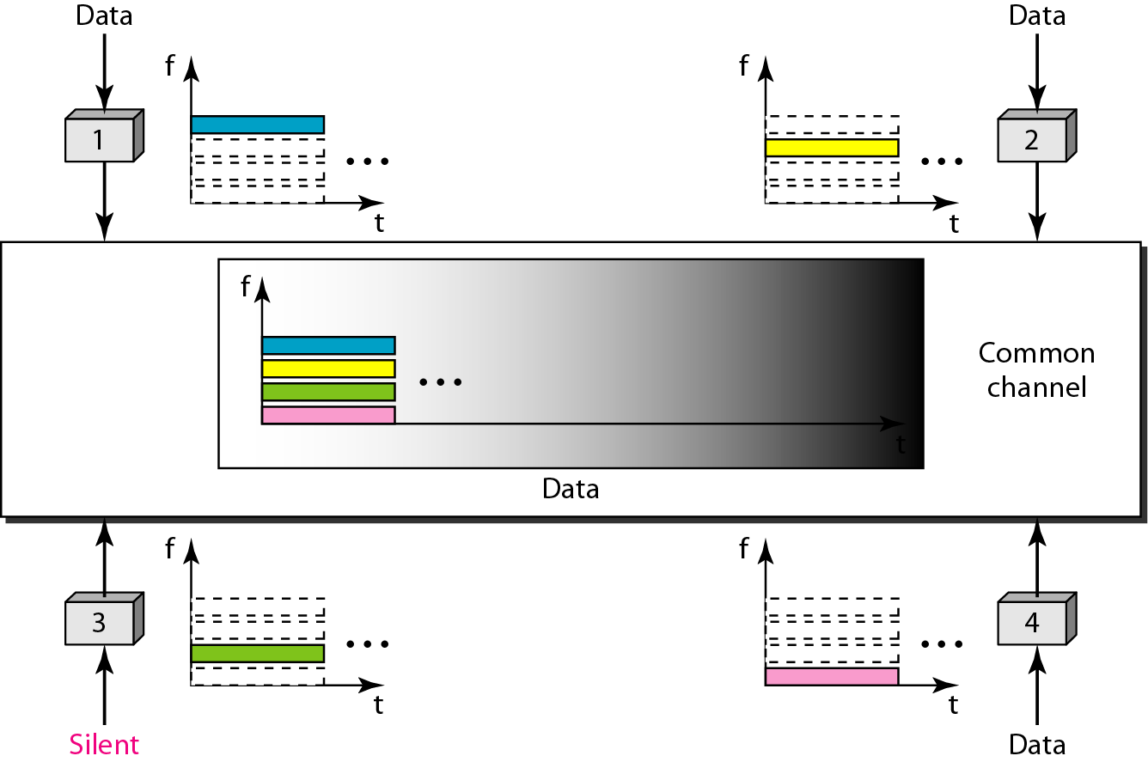
Frequency-division multiple access (FDMA)

Slide 13
TDMA
The stations share the bandwidth of the channel in time.
Each station is allocated a time slot during which it can send data.
Problem - synchronization between the different
stations.
Each station needs to know the beginning of its slot and the location of its slot – difficult - propagation delays - use insert guard times
Synchronization - preamble bits - at the beginning of each slot.

Slide 14
TDMA
TDM - physical layer technique that combines the data from slower channels and transmits them by using a faster channel.
The process uses a physical multiplexer that interleaves data units from each channel.
TDMA- access method in DL
The data-link layer in each station tells its physical layer to use the allocated time slot.

Slide 15
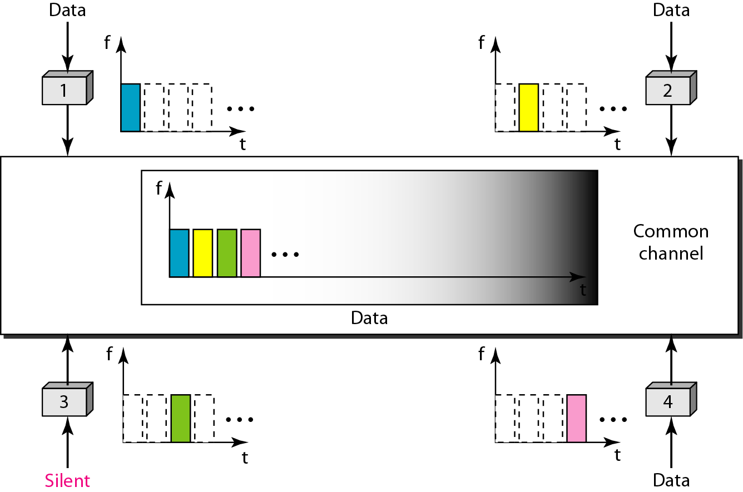
Time-division multiple access (TDMA)

Slide 16
Note
In TDMA, the bandwidth is just one channel that is timeshared between different stations.

Slide 17
Note
In CDMA, one channel carries all transmissions simultaneously.

Slide 18
CDMA
CDMA is based on coding theory.
Each station is assigned a code, which is a sequence of numbers called chips
They are called orthogonal sequences and have the certain properties

Slide 19
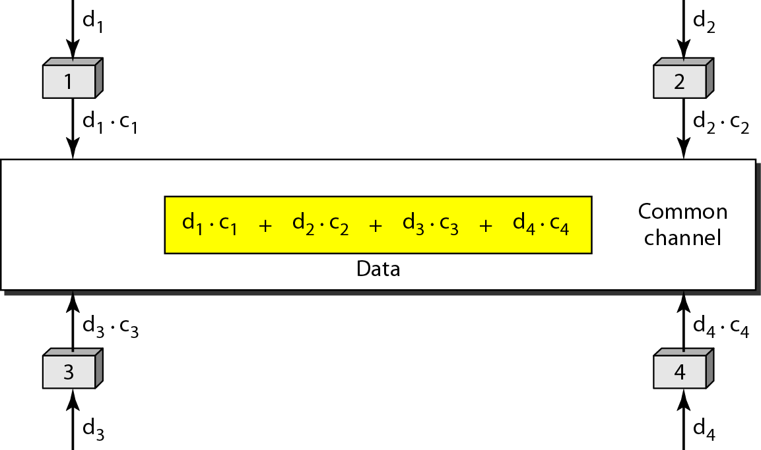
Simple idea of communication with code

Slide 20
Chip sequences

Slide 21
Properties
1. If we multiply each code by another, we get 0.
2. If we multiply each code by itself, we get 4

Slide 22
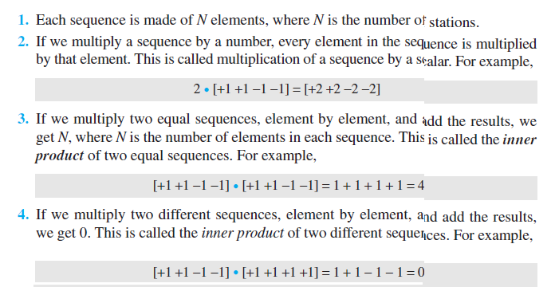
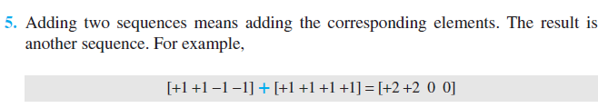

Slide 23
Data representation in CDMA

Slide 24
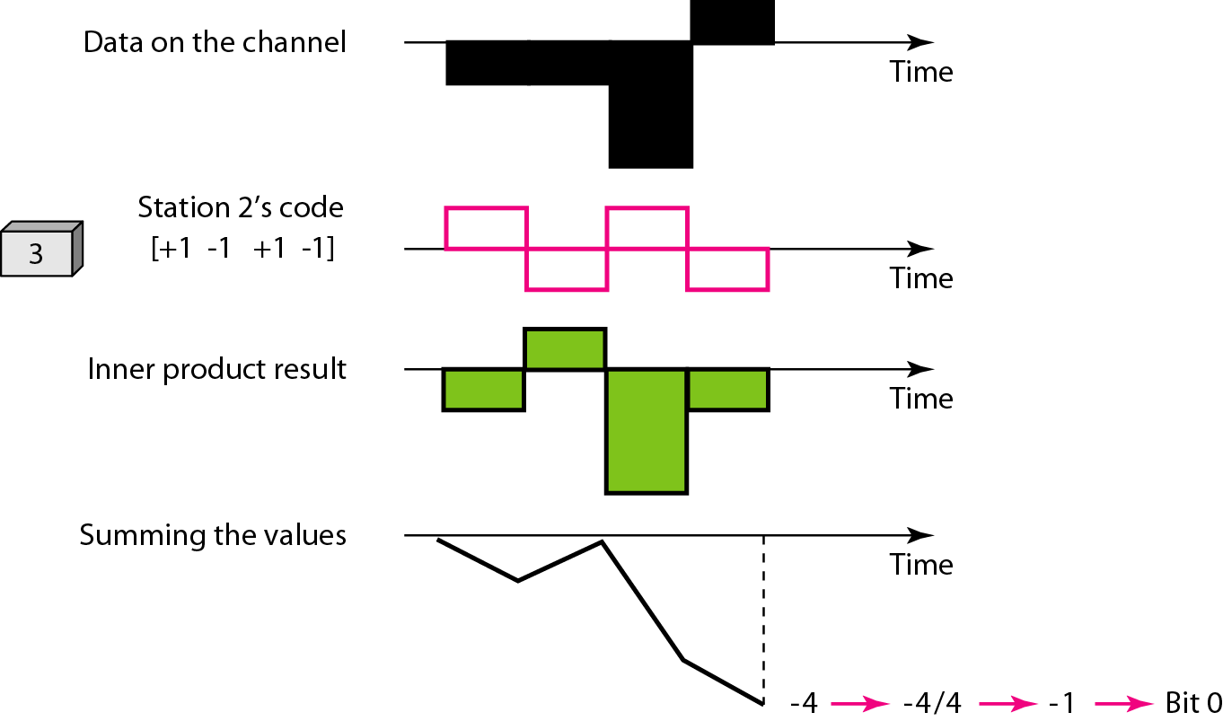
Decoding of the composite signal for one in CDMA

Slide 25
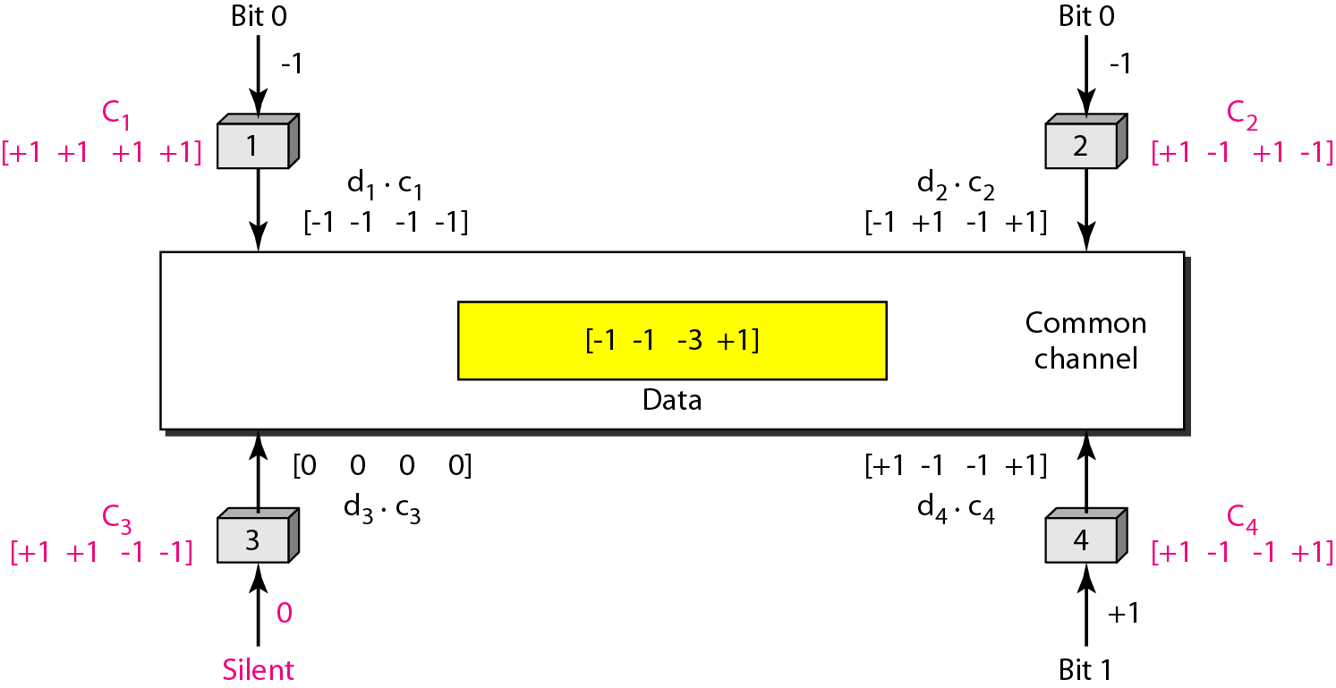
Sharing channel in CDMA

Slide 26
Station 3 wants to listen to station 2, then decode with station 2 code

Slide 27
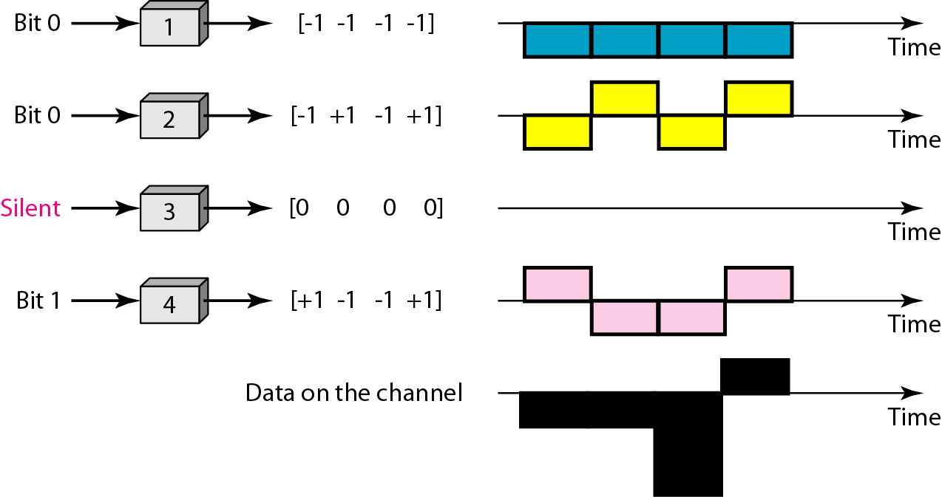
Digital signal created by four stations in CDMA

Slide 28
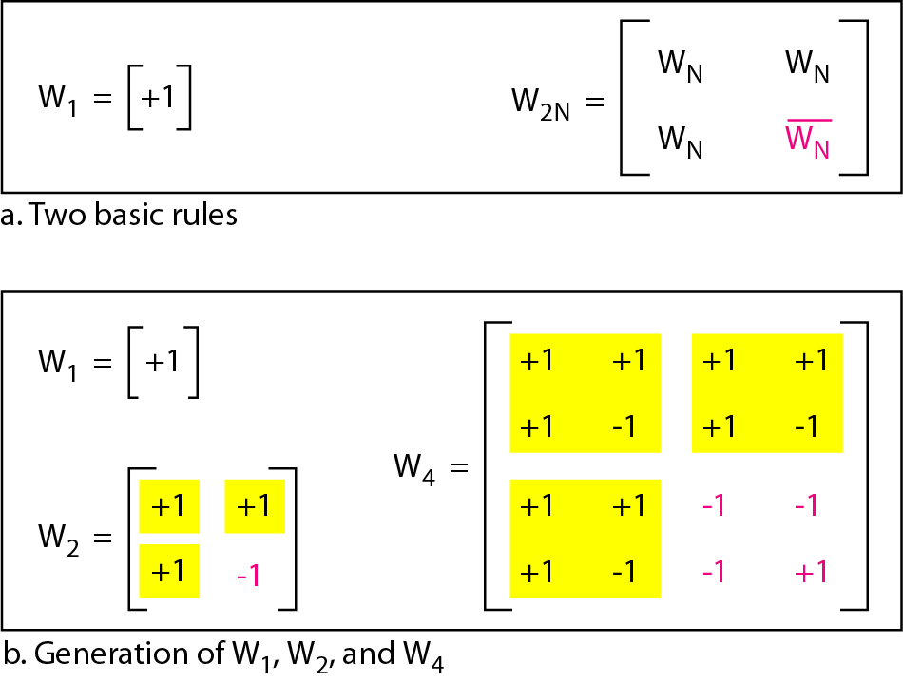
General rule and examples of creating Walsh tables

Slide 29
Note
The number of sequences in a Walsh table needs to be N = 2^{m}.

Slide 30
Example
Find the chips for a network with
a. Two stations b. Four stations
Solution
We can use the rows of W₂ and W₄ in Figure 12.29:
a. For a two-station network, we have [+1 +1] and [+1 −1].
b. For a four-station network we have [+1 +1 +1 +1], [+1 −1 +1 −1], [+1 +1 −1 −1], and [+1 −1 −1 +1].

Slide 31
Example
What is the number of sequences if we have 90 stations in our network?
Solution
The number of sequences needs to be 2^{m}. We need to choose m = 7 and N = 2⁷ or 128. We can then use 90 of the sequences as the chips.

Slide 32
Example
Prove that a receiving station can get the data sent by a specific sender if it multiplies the entire data on the channel by the sender’s chip code and then divides it by the number of stations.
Solution
Let us prove this for the first station, using our previous four-station example. We can say that the data on the channel D = (d1 ⋅ c1 + d2 ⋅ c2 + d3 ⋅ c3 + d4 ⋅ c4). The receiver which wants to get the data sent by station 1 multiplies these data by c1.

Slide 33
Example
When we divide the result by N, we get d₁ .

Slide 34
Check Your Understanding
Select is used by ____________ station
When same codes are multiplied, the resulting code will be ____.
CDMA shares channel from ____________ stations.

Slide 35
Outcome
Student should be able to
Explain the various controlled access MAC protocols such as reservation, polling and token passing
Understand the channelization methods such as FDMA, TDMA and CDMA

Slide 36
THANK YOU

